Slide 1
What’s new in
CluedIn 2026.01
release
2026 | cluedin.com
Notes:
Welcome to CluedIn’s 2026.01 release — a release focused on simplifying the data steward experience by making everyday workflows faster, clearer, and easier to use. This update introduces a refreshed UI and navigation, along with major usability improvements across Search, Golden Records, Explain Logs, and administration. The goal is simple: reduce friction and help you focus on managing and trusting your data.

Slide 2

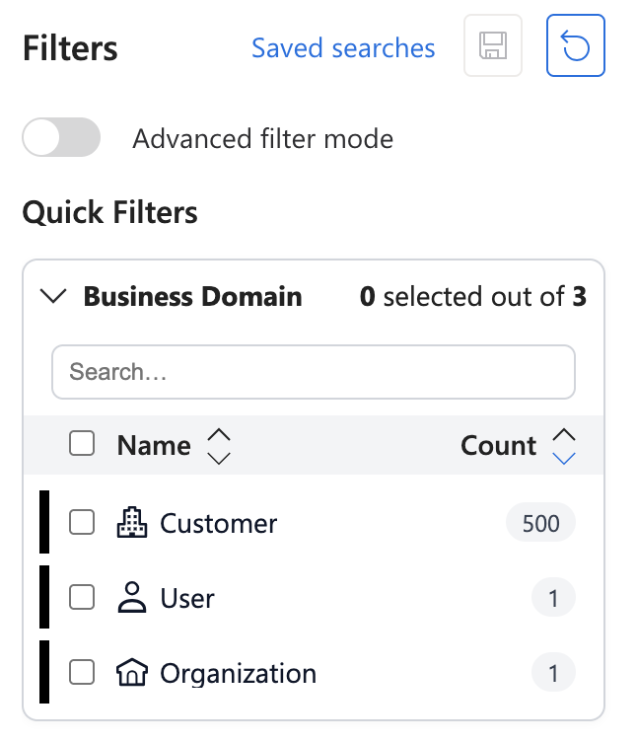



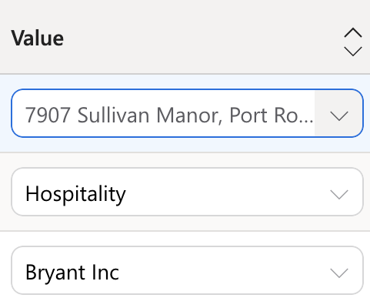




What’s new in this release
This release introduces improvements across three key areas:
A refreshed UI and navigation experience
Simplified and more powerful Golden Record and Search workflows
New AI Job Builder capabilities for more efficient data processing
Notes:
This release introduces improvements across three key areas:
A refreshed UI and navigation experience
Simplified and more powerful Golden Record and Search workflows
New AI Job Builder capabilities for more efficient data processing
Let’s take a closer look.

Slide 3
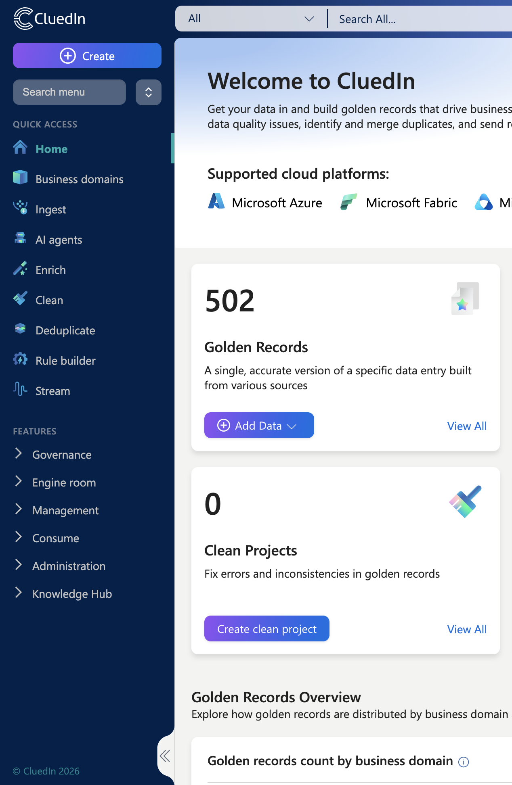

A simpler, more intuitive UI
Notes:
Based on ongoing user feedback, we’ve made a series of UI and UX improvements designed to make CluedIn easier to navigate and more efficient to use day to day.
This includes a new theme, redesigned menus, improved performance, and clearer access to the tools you need most.

Slide 4
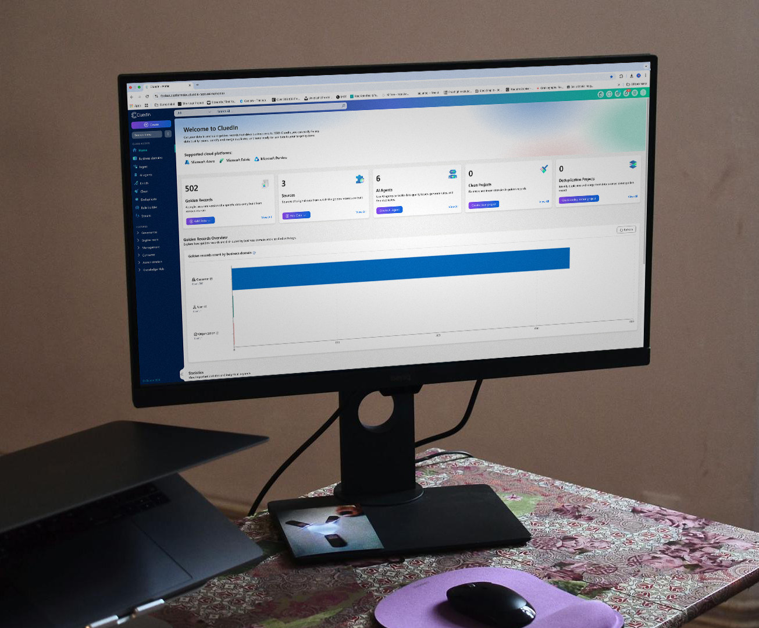
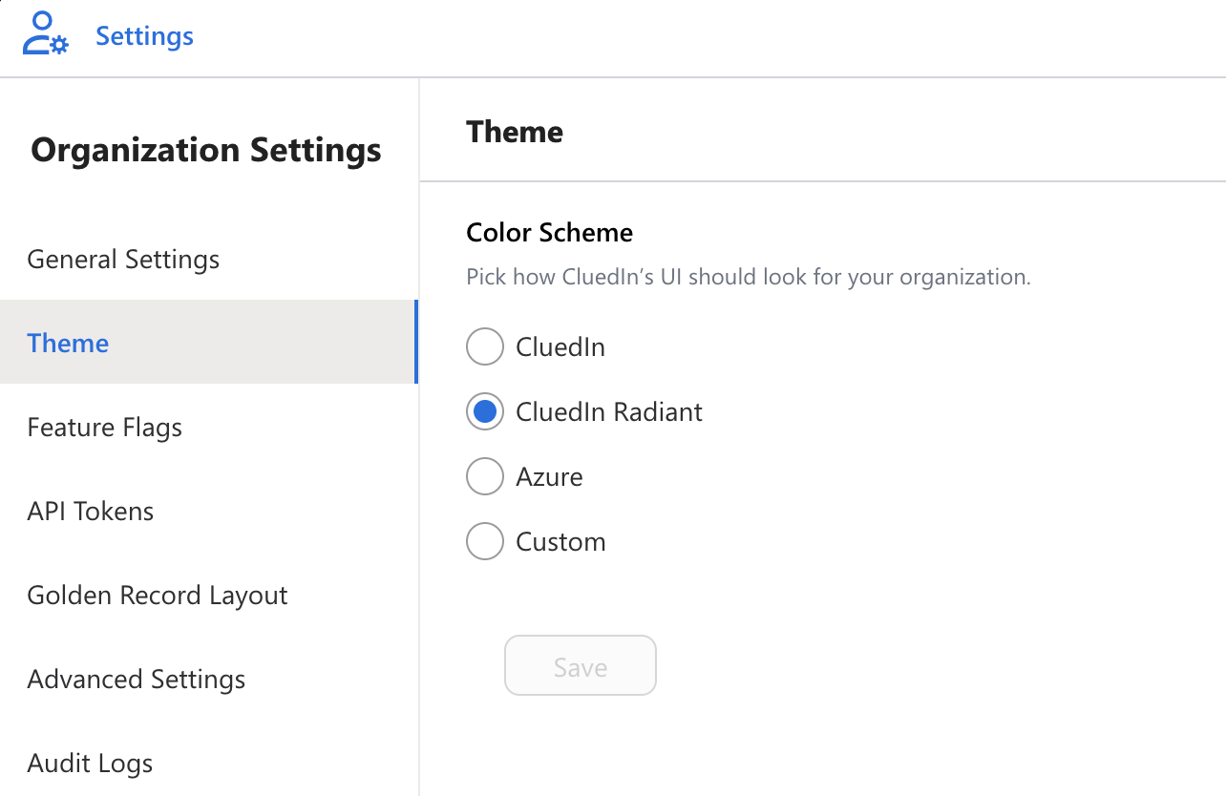
NEW!
Notes:
We’ve introduced a new default theme called Radiant.
Radiant improves visual clarity and consistency across the platform, with better contrast and readability on data-dense screens — helping data stewards work comfortably and confidently for longer periods of time.

Slide 5
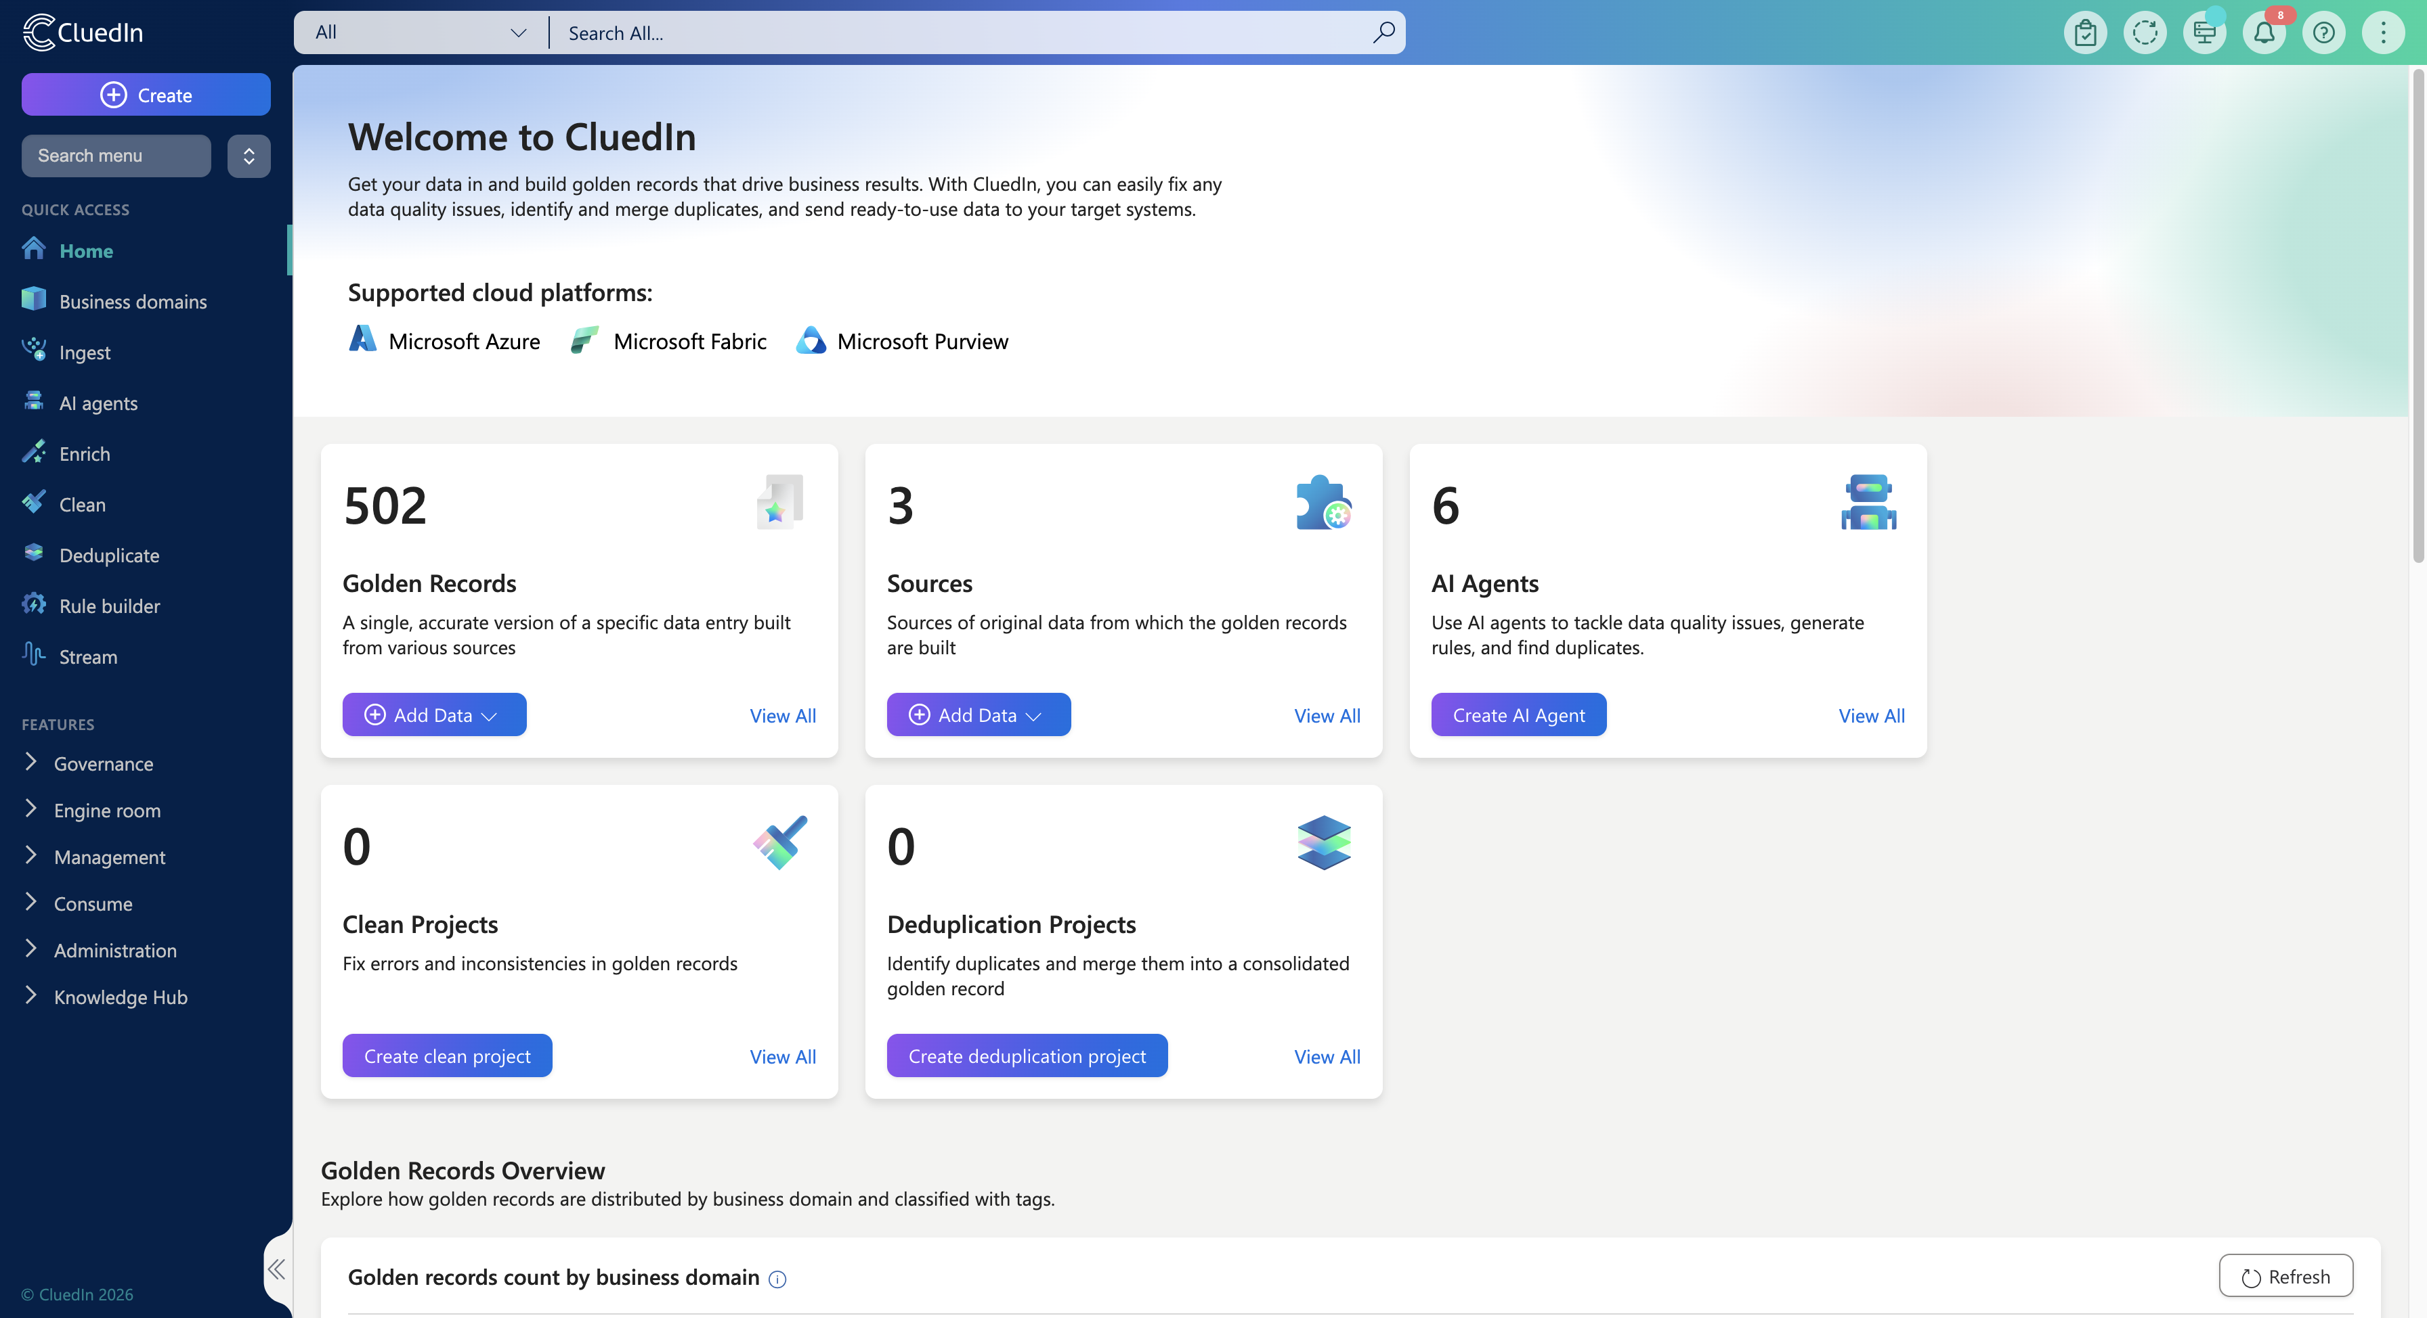

Notes:
The main navigation has been redesigned to make it easier to find and access key areas of the platform.
Related functionality is now grouped more logically, and the new menu provides quick access to commonly used areas, reducing the time it takes to move between tasks and workflows.
Menu items are also now role-aware, meaning users only see what they have access to — keeping the interface focused and relevant.

Slide 6
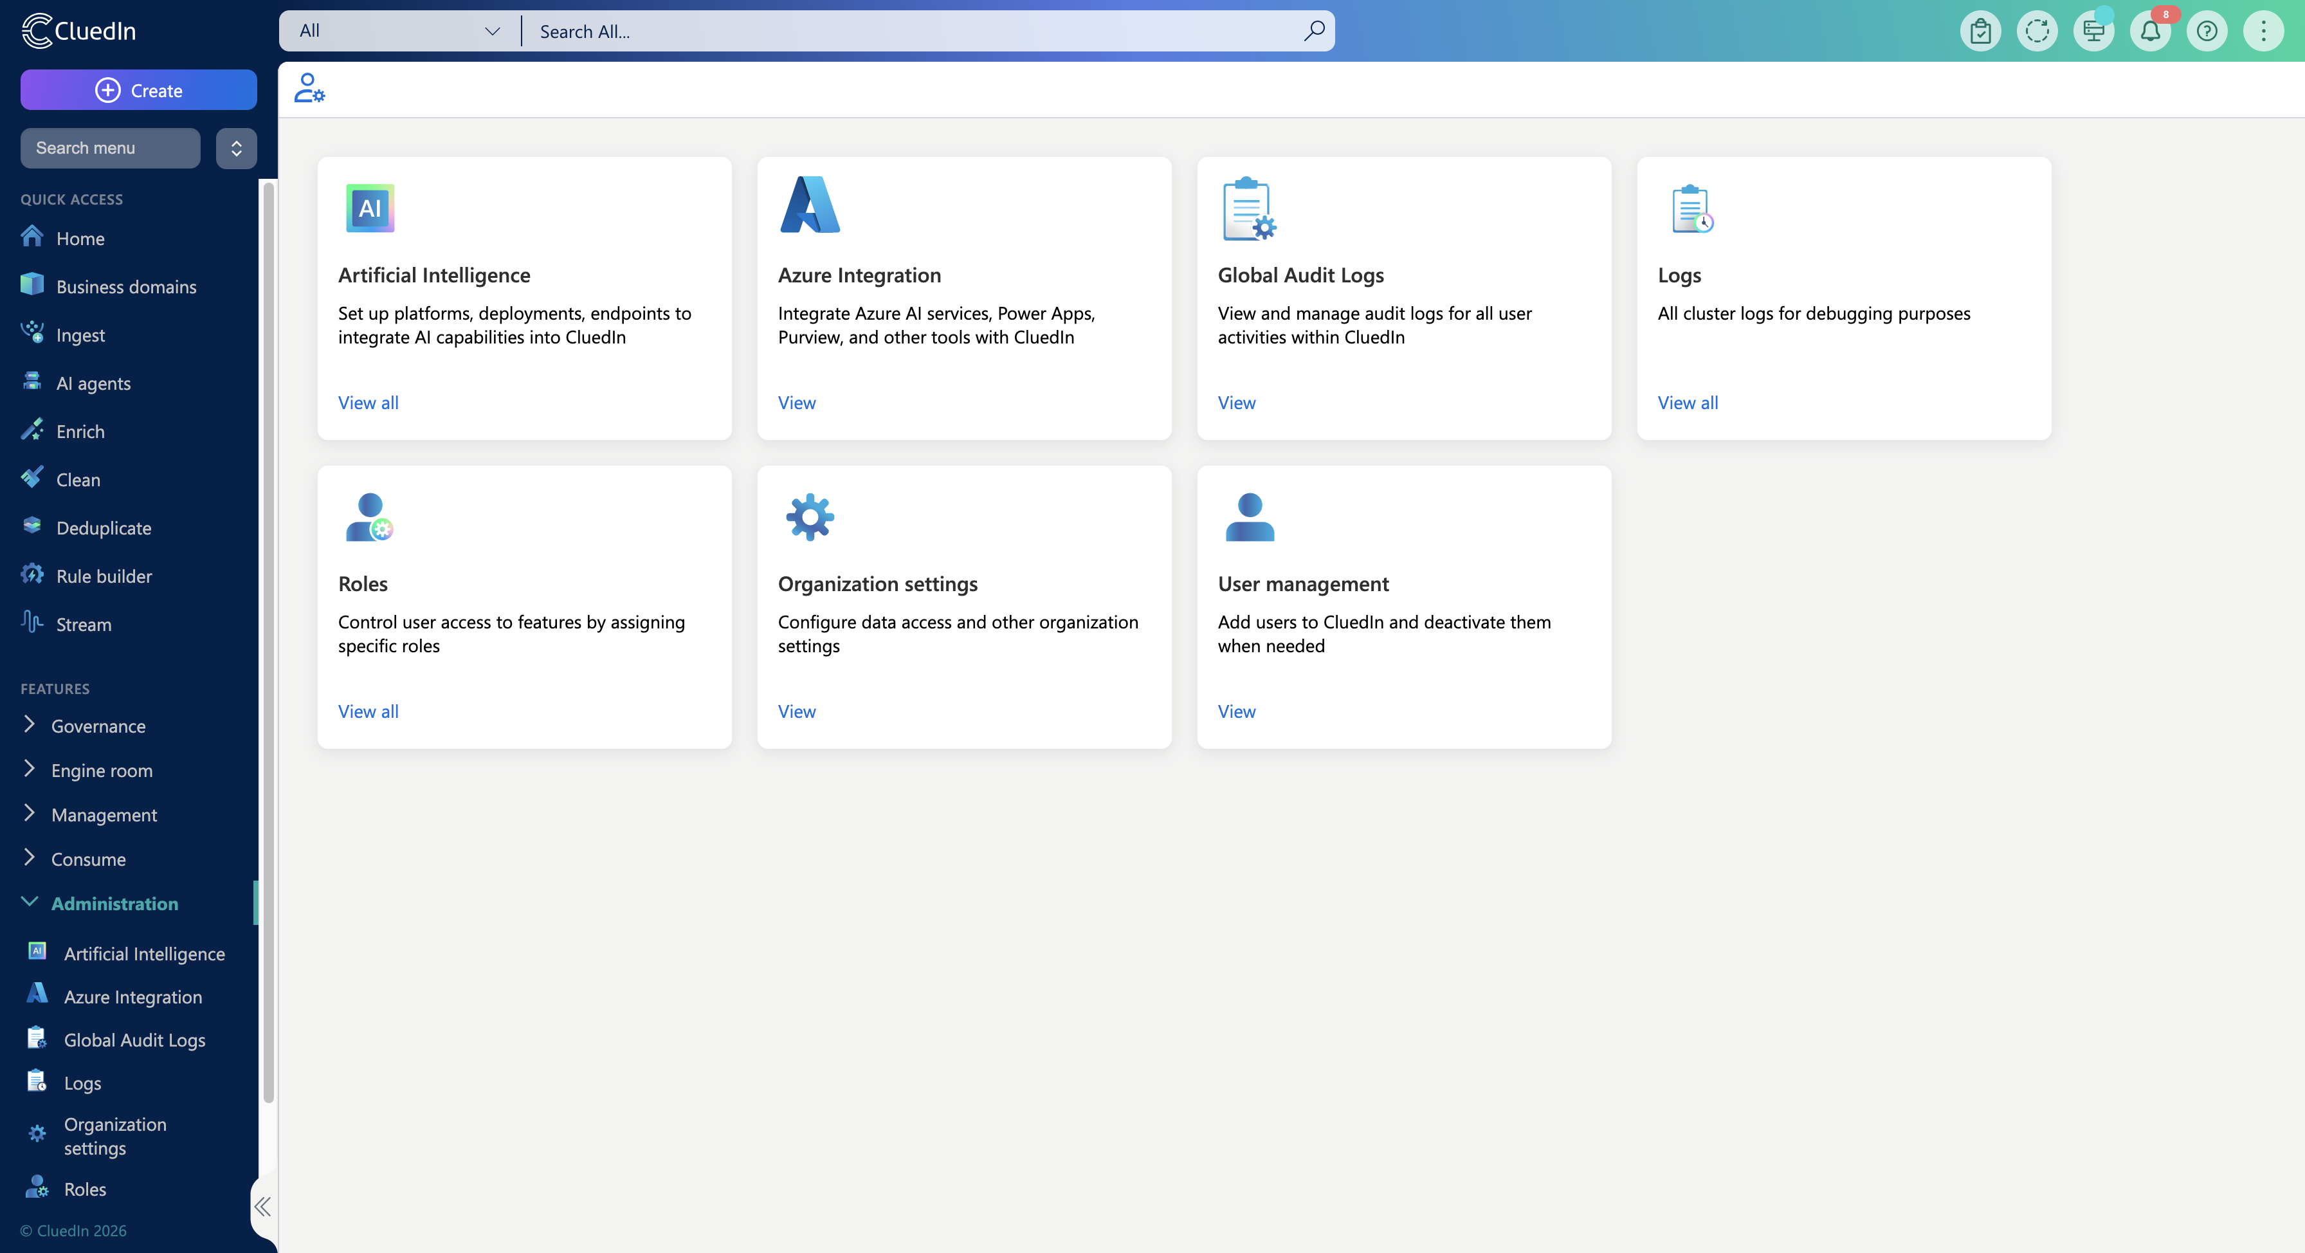
Notes:
As CluedIn has grown, administrative settings had become spread across multiple areas.
In this release, administration has been consolidated into a clearer structure:
All organization-level settings are now available on a single page with sub-navigation
User-specific settings are available in one dedicated place
This makes configuration easier to understand, manage, and maintain.

Slide 7
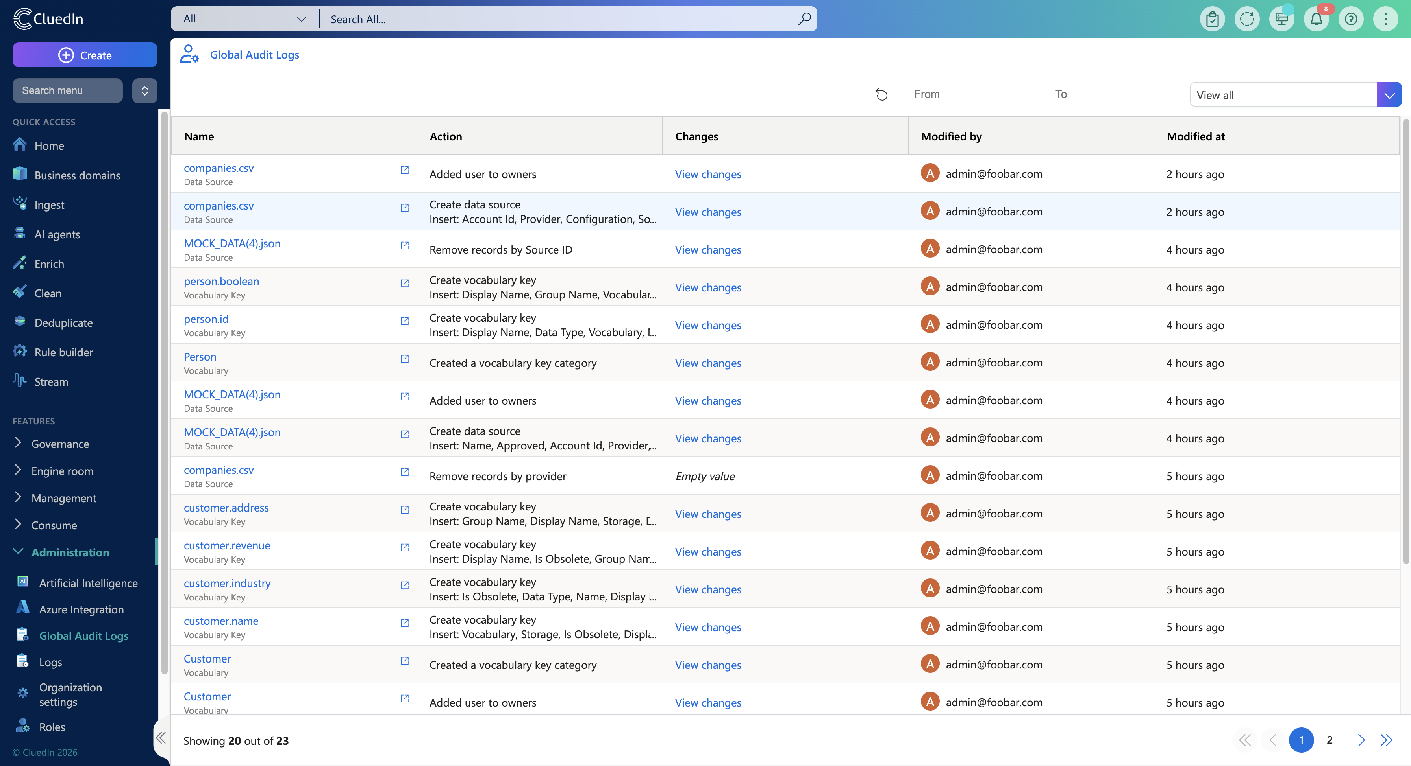
Notes:
We’ve also improved performance when loading Data Sets, resulting in faster page loads and smoother interactions — especially when working with large volumes of data.
To support governance and transparency, we’ve introduced Global Audit Logs, giving you a centralized view of changes to rules, deduplication configurations, and data set removals — all from a single page.

Slide 8
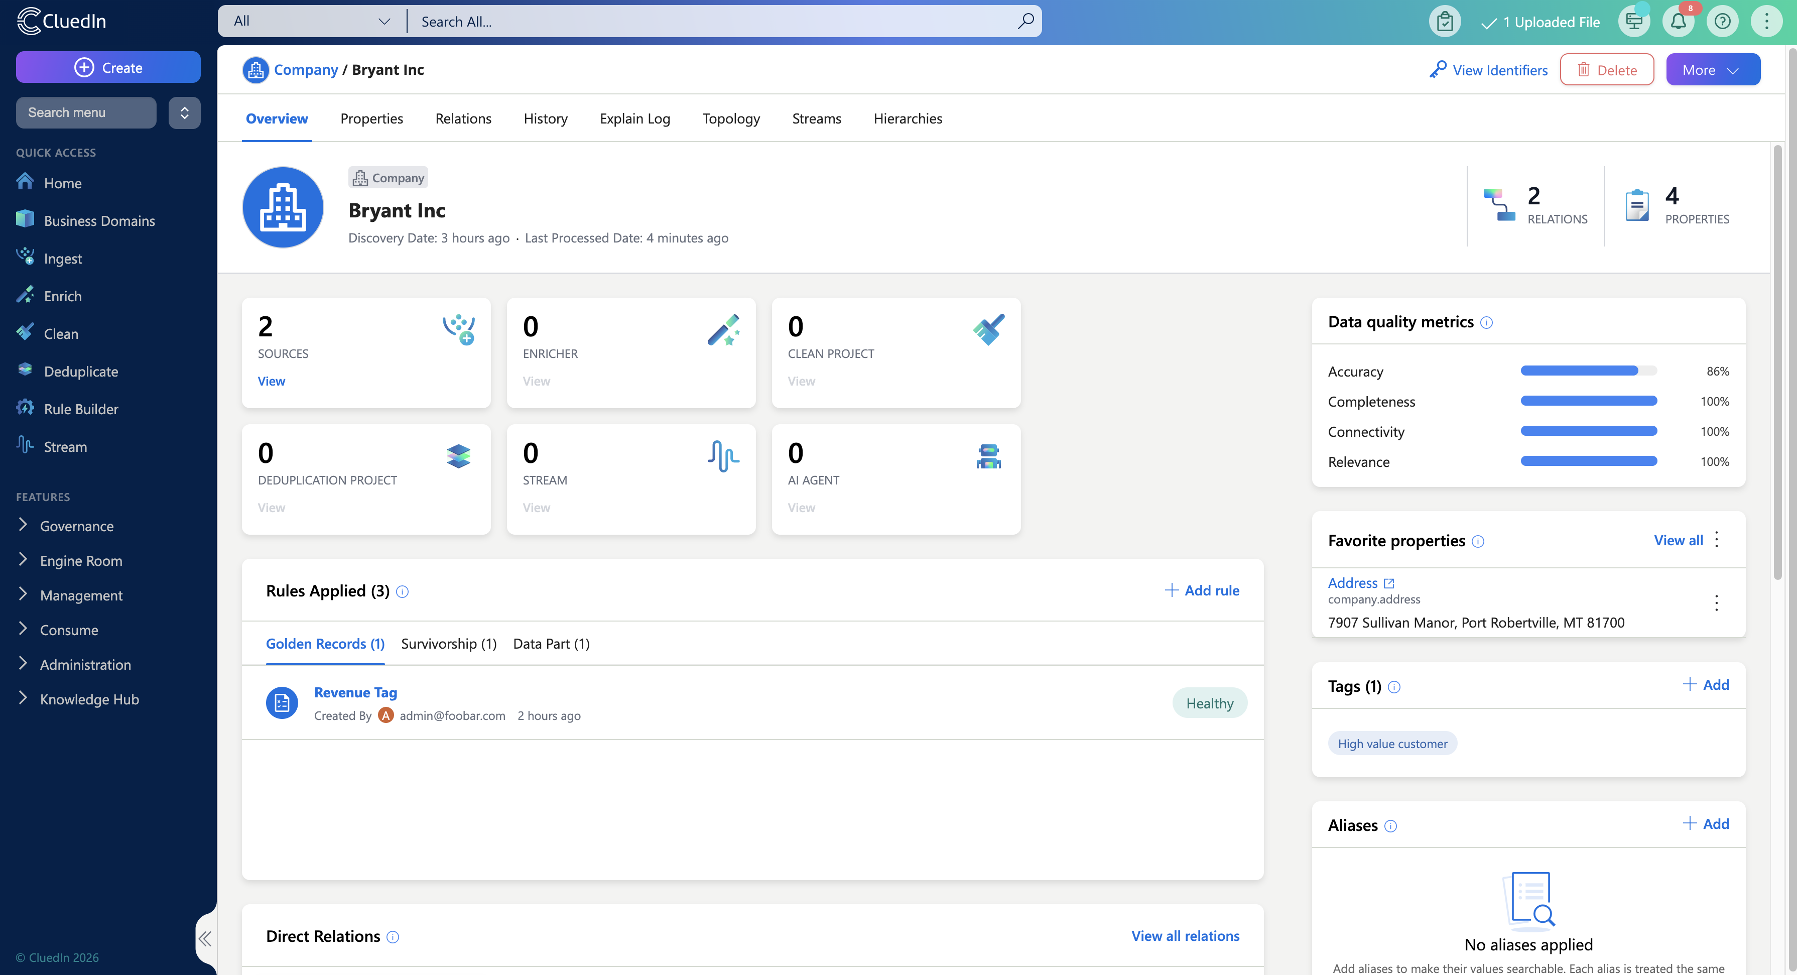
A New Golden Record Experience
Notes:
The Golden Record sits at the core of the data steward experience.
In 2026.01, the Golden Record has been redesigned with a set of dedicated pages that make it easier to understand, validate, and manage records throughout their lifecycle.

Slide 9
Notes:
The new Overview Page provides immediate context when opening a Golden Record, surfacing key information upfront.

Slide 10
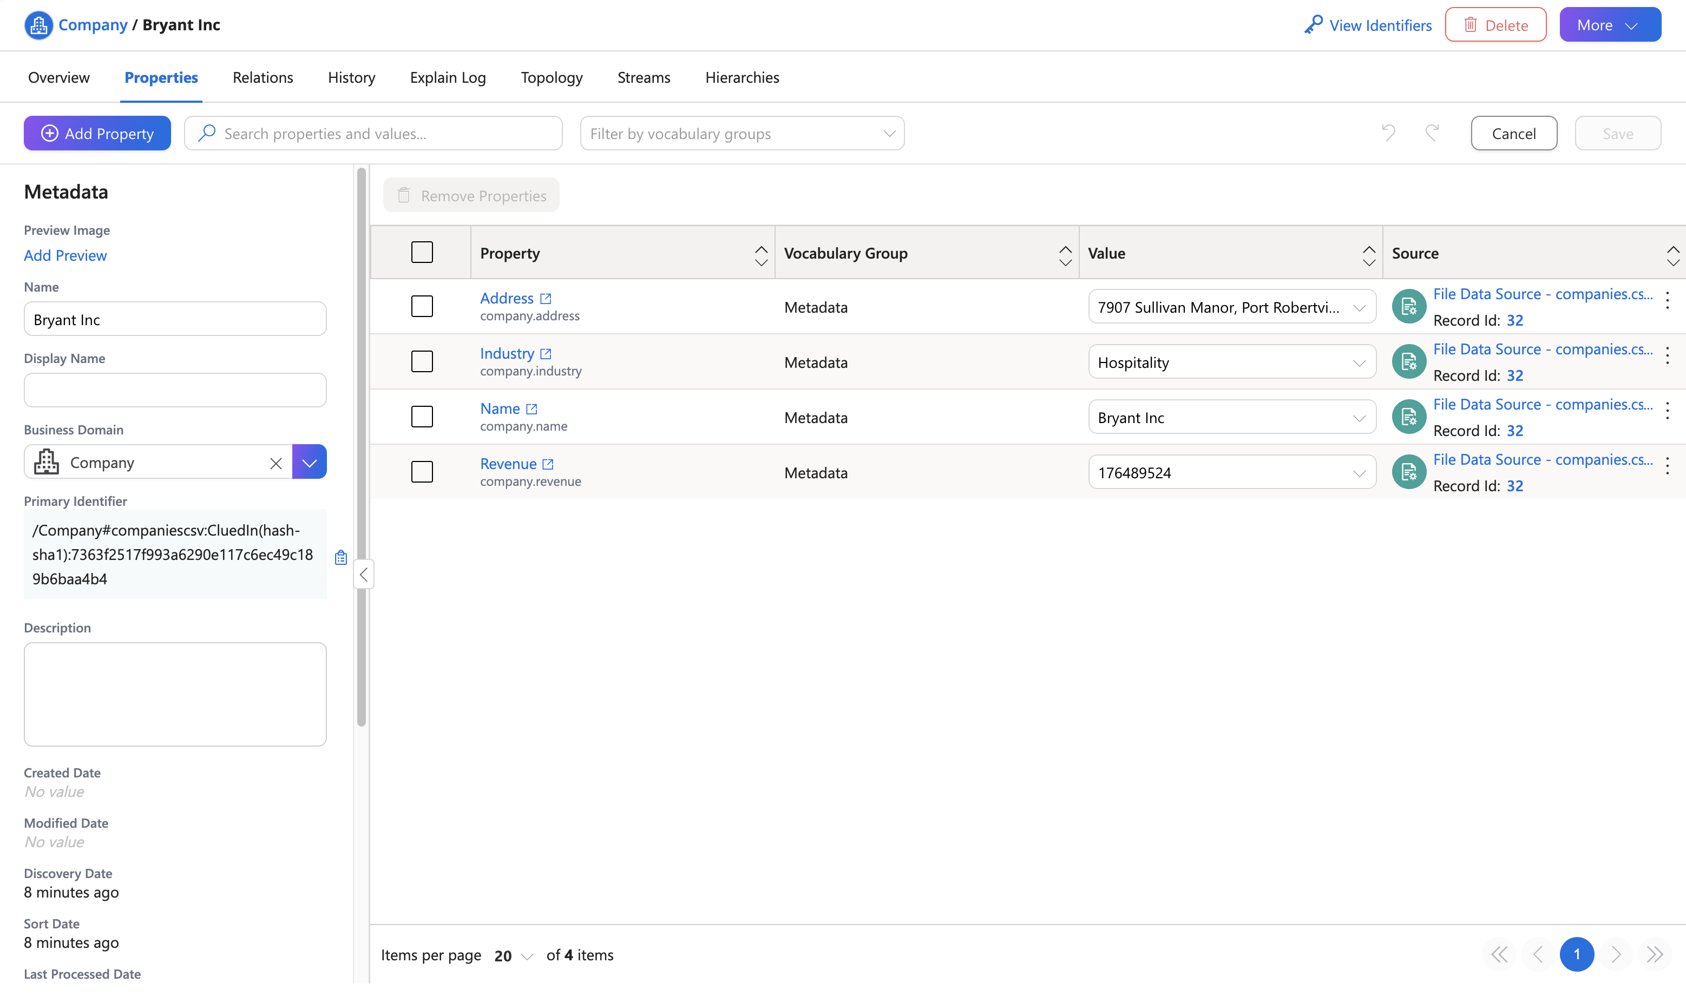
Notes:
The Property Page brings all editable attributes into a single view, allowing faster updates, greater consistency, and a more focused editing experience — without navigating across multiple screens.

Slide 11
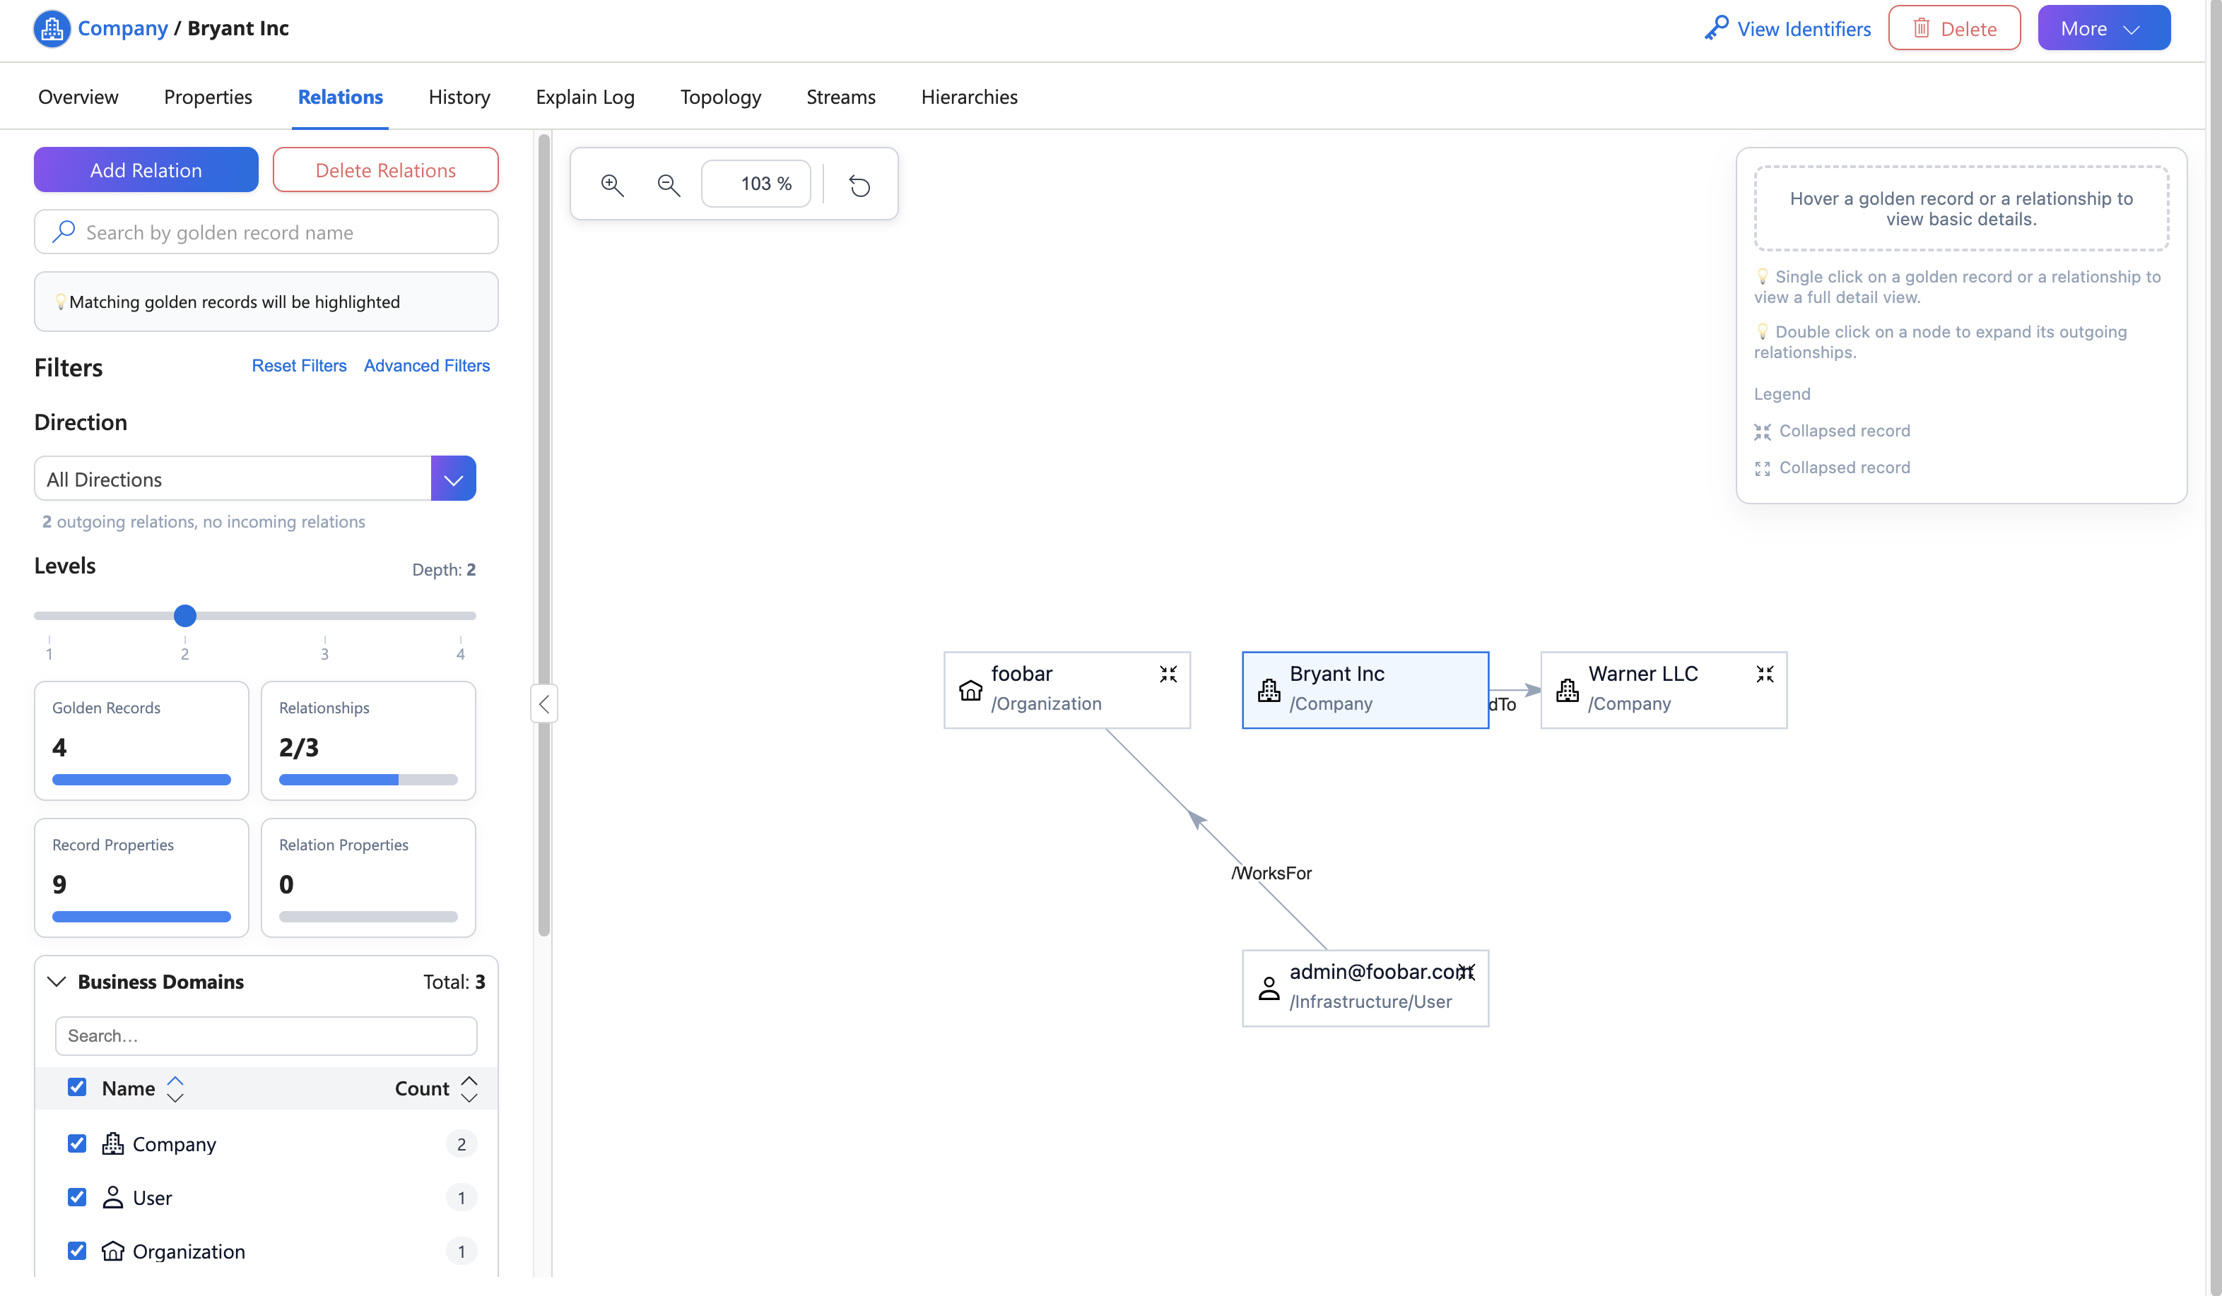
Notes:
The redesigned Relation Page makes it easier to explore and manage connections between records.
You can now add and edit relations directly within the Relations tab, and use advanced filtering — aligned with Global Search — to quickly find relevant relationships, even in complex data sets.

Slide 12
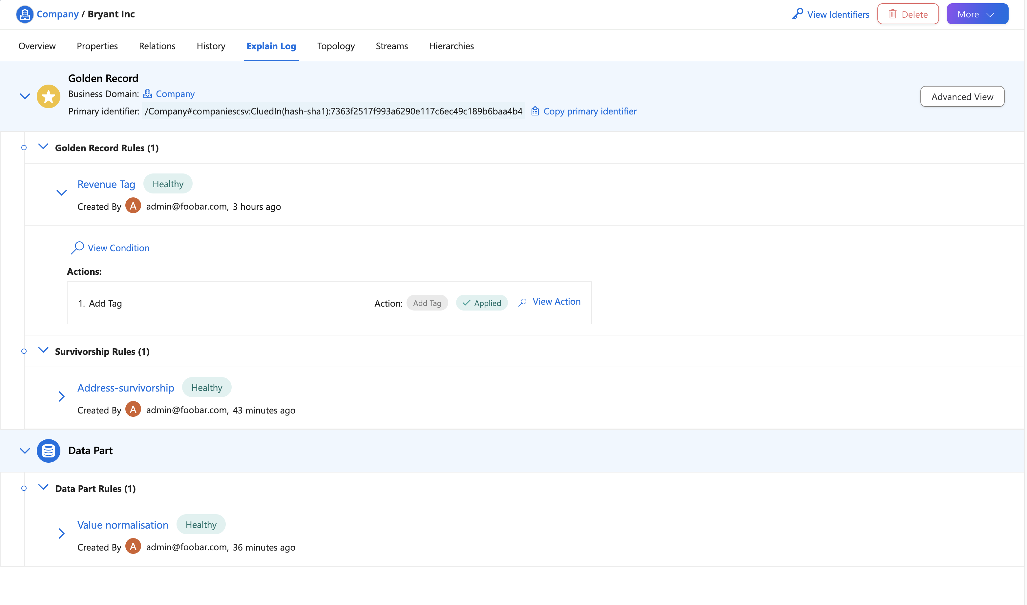
Notes:
The Explain Log has also been simplified, focusing on the most relevant information so it’s easier to understand how Golden Records are created, validate outcomes, and troubleshoot issues.

Slide 13
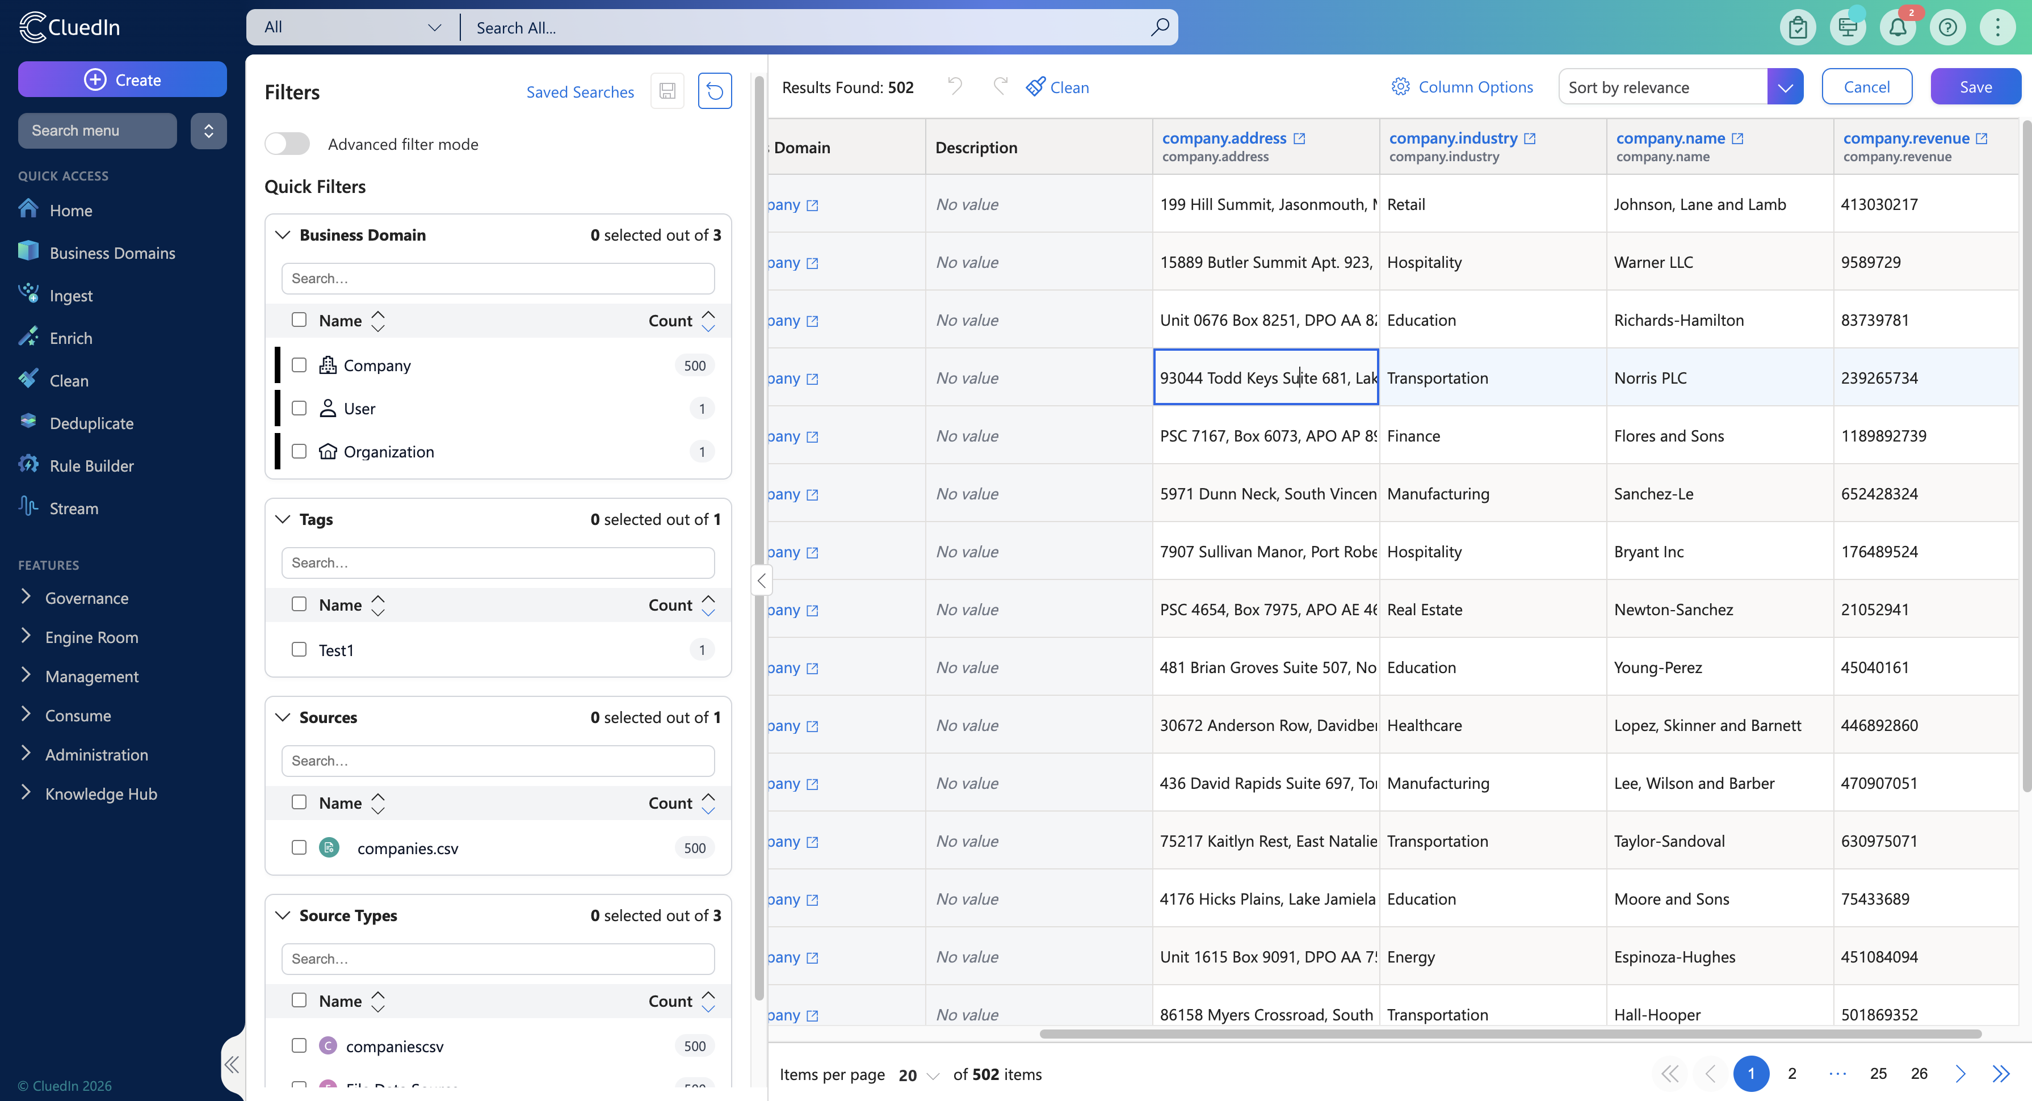
Notes:
Search is one of the most frequently used tools for data stewards, and it’s now significantly easier to use.
Filters are always visible in a left-hand panel, alongside search history, making it easy to revisit and refine previous queries without starting over.
Advanced filters have been simplified, and vocabulary key values can now be edited directly from the Search page — supporting text, boolean, and reference values — so quick corrections can be made without leaving the search context.

Slide 14
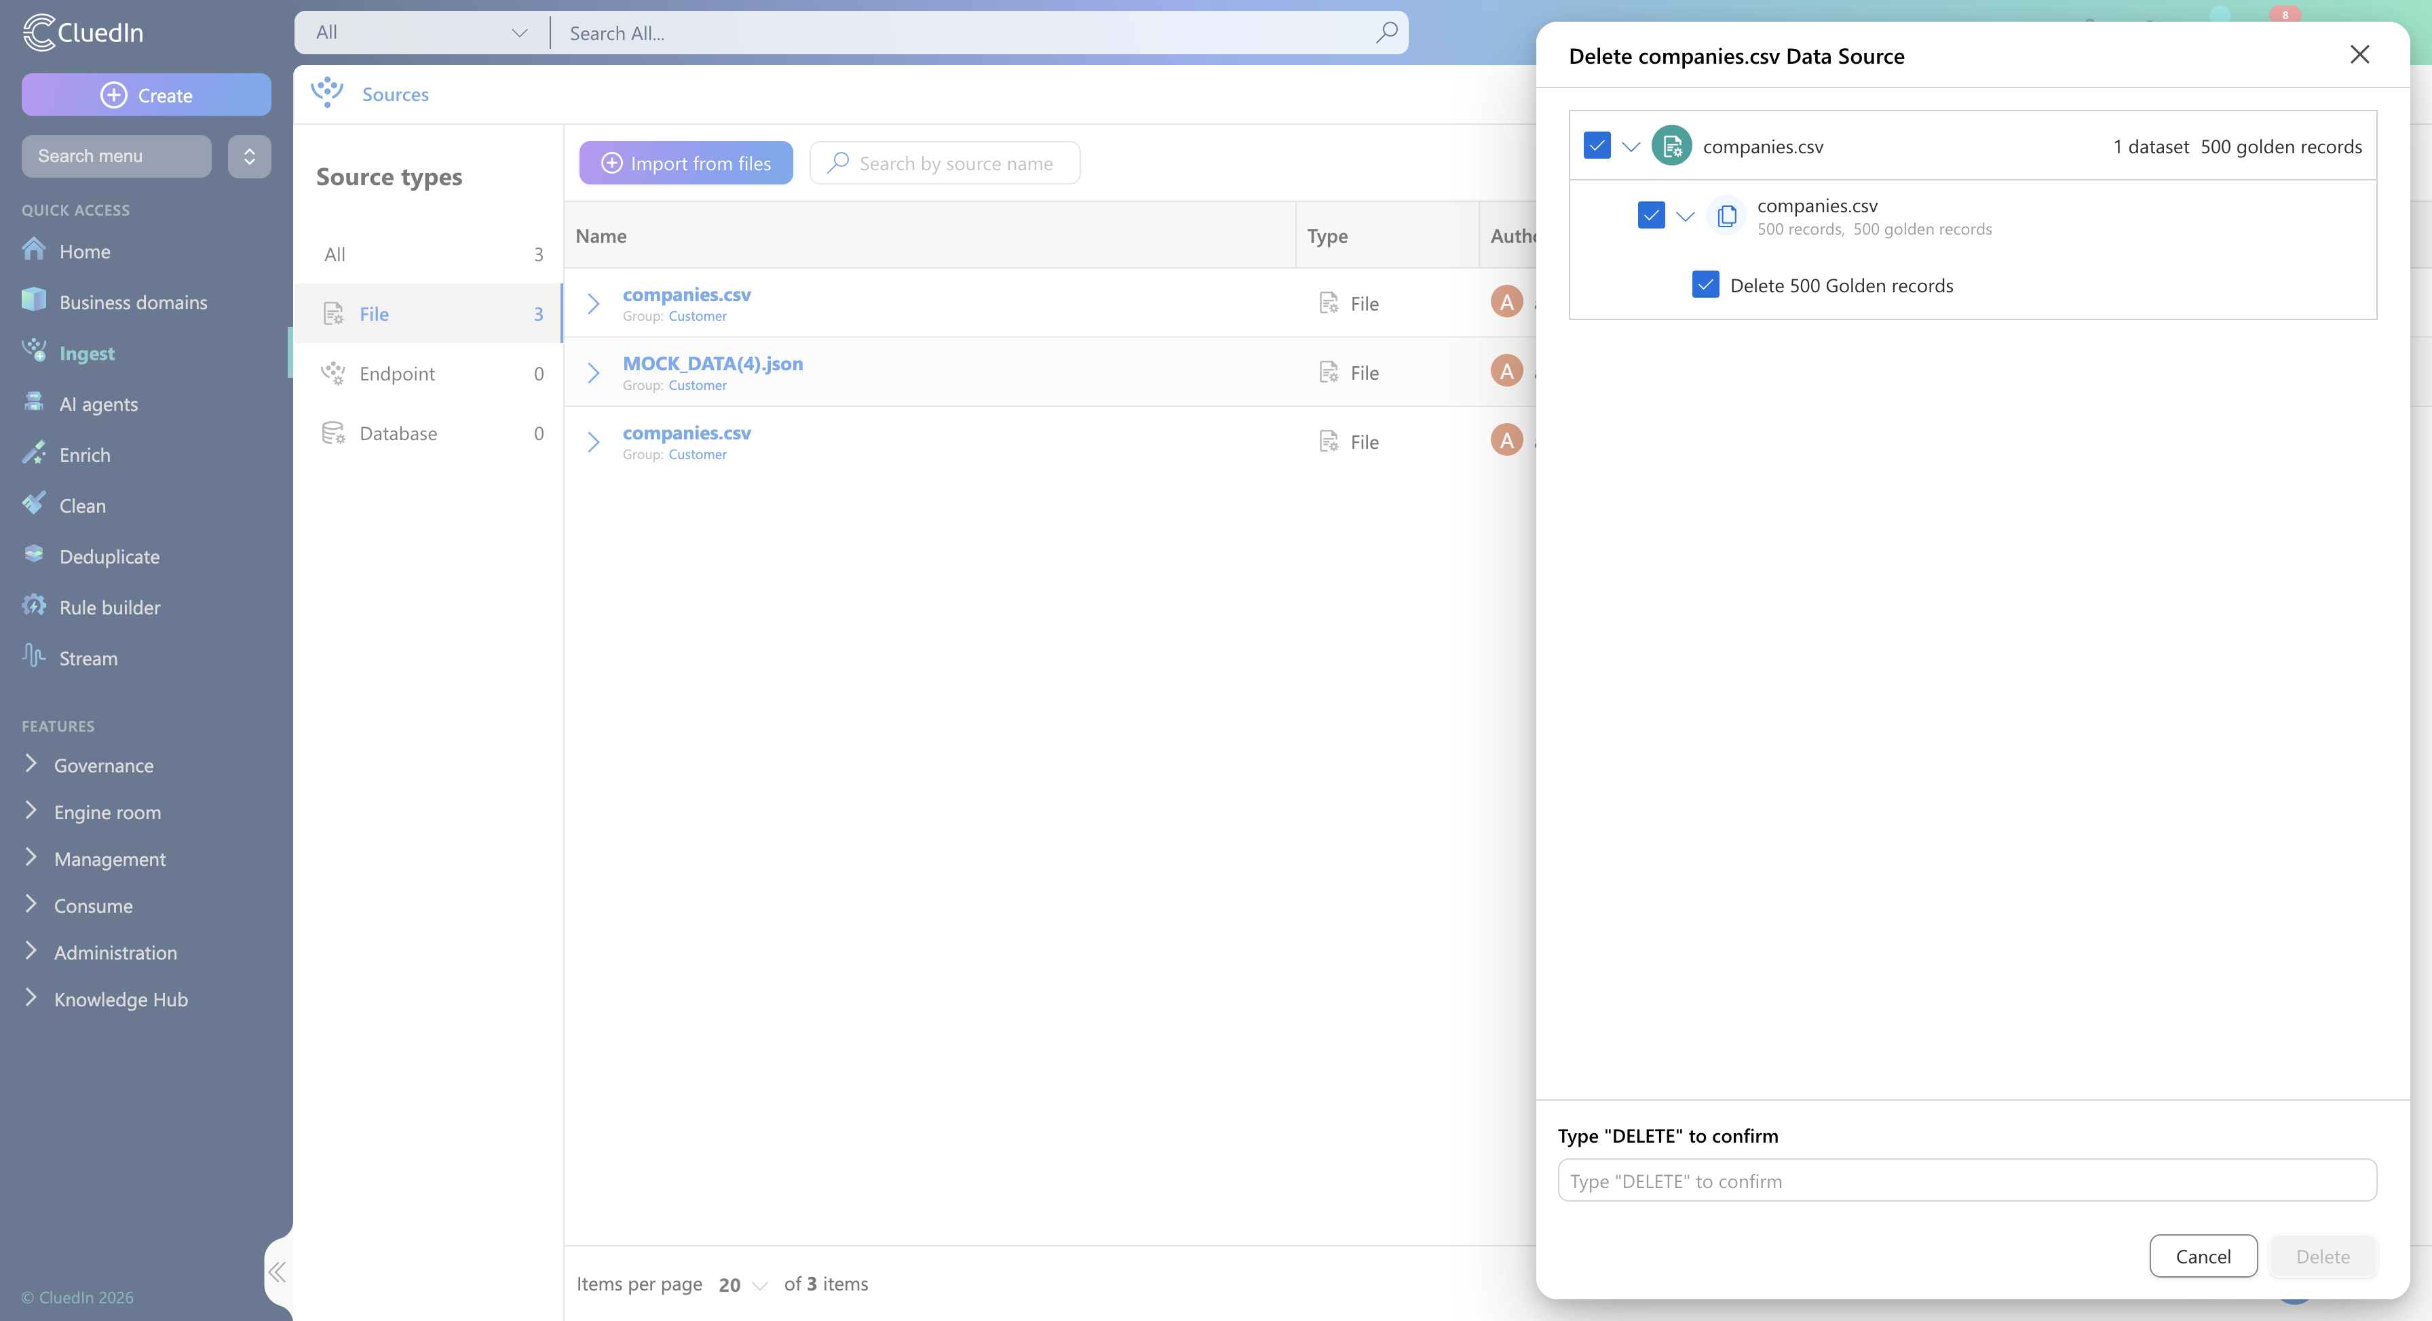
Notes:
Managing data sources is now simpler and safer.
You can remove entire data sources or groups in a single action, provided you have the required permissions — reducing repetitive steps while maintaining full control.

Slide 15
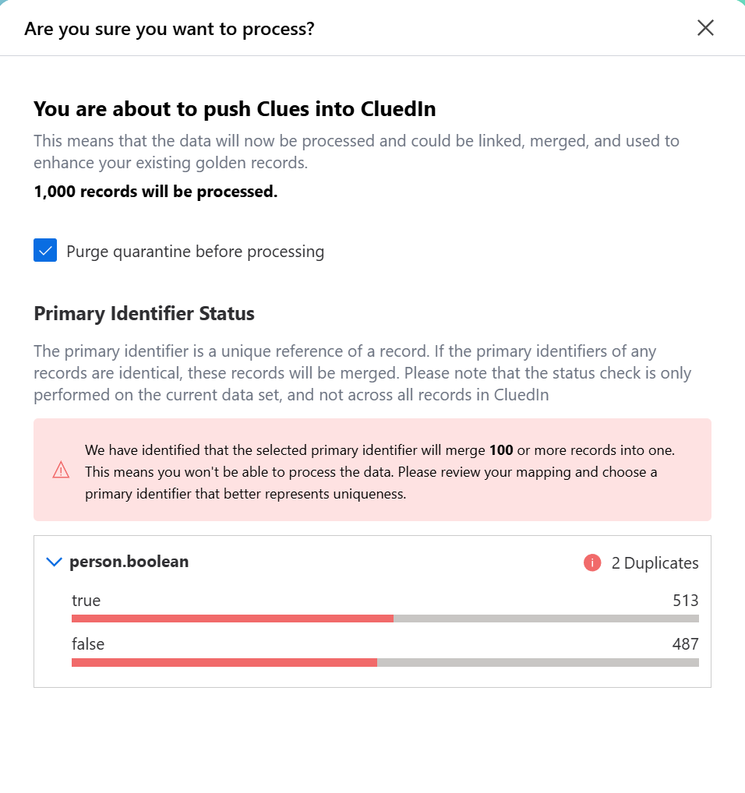
Notes:
As data volumes grow and matching becomes more automated, preventing incorrect merges becomes critical.
With Over-Merging Protection, CluedIn helps safeguard against unintentionally merging records that represent different real-world entities. Additional checks and constraints are applied during the merge process to ensure that only records that truly belong together are combined into a single Golden Record.
This reduces the risk of data corruption, improves trust in your master data, and gives data stewards greater confidence when working with high-volume or automated matching scenarios.

Slide 16
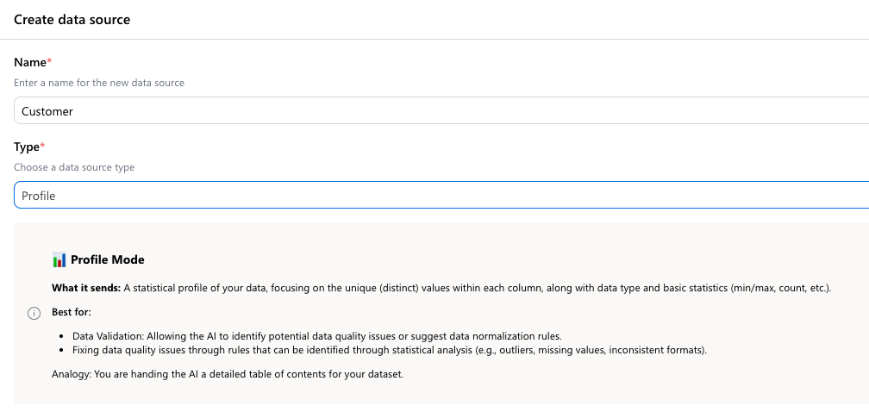
Notes:
This release also introduces updates to the AI Job Builder.
A new Profile data source allows AI skills to operate on aggregated or profile-level data instead of processing records row by row. This enables more efficient execution for rule-based and analytical jobs.

Slide 17

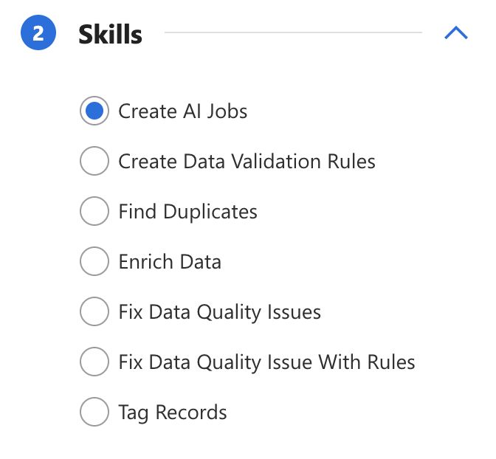
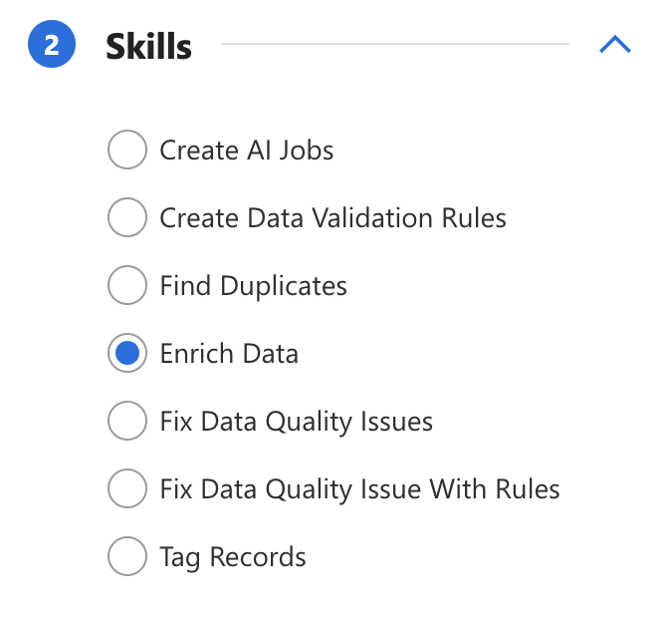


Notes:
Two new AI skills have been added:
Create AI Jobs
This skill analyses your data and automatically creates additional AI Jobs using other available AI skills — reducing manual setup and accelerating workflows.
Enrich Data
This skill uses AI to enrich existing data by filling in missing or incomplete values, improving overall data completeness and quality.

Slide 18
What this release unlocks
Faster navigation and clearer workflows
Easier editing, filtering, and validation of Golden Records
Better transparency, governance, and performance
More efficient AI-driven job creation and enrichment
Notes:
Together, these updates deliver a simpler and more efficient data stewardship experience:
Faster navigation and clearer workflows
Easier editing, filtering, and validation of Golden Records
Better transparency, governance, and performance
More efficient AI-driven job creation and enrichment
All designed to reduce friction and help you trust your data faster.

Slide 19
Notes:
That concludes the overview of what’s new in CluedIn 2026.01.
With a refreshed UI, improved core workflows, and smarter AI tooling, this release helps data stewards spend less time navigating the platform - and more time improving data quality and delivering value.
Thanks for watching, and we’ll see you in the next release.

