Slide 1
CluedIn Fundamentals: Ingesting a database table
Bring your data into CluedIn as-is, no upfront modelling required

Slide 2
Continue to implement the training use case
Ingest a database table to CluedIn
Training agenda
Explore how CluedIn generates golden records
Uncover what’s next in your CluedIn learning journey

Slide 3


Practical use case
Creating a single source of truth for customer data by integrating information from two primary systems:
CRM
ERP

Slide 4
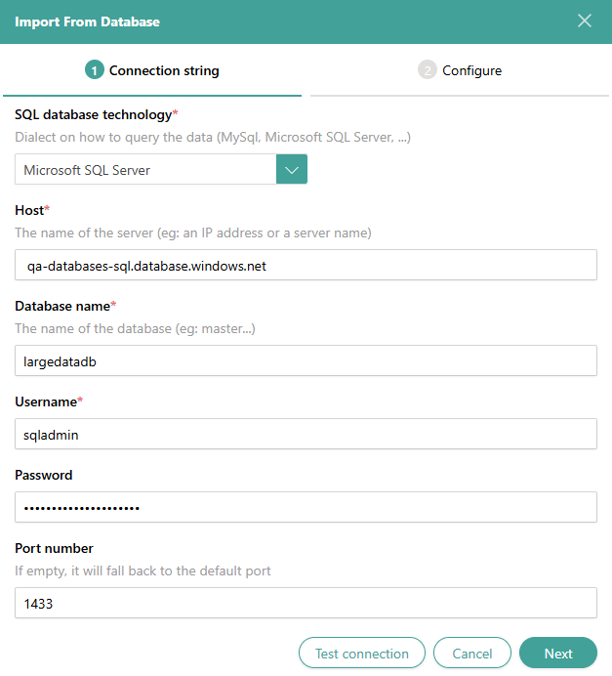
The process of ingesting a database table into CluedIn consists of four simple steps:
Configure database connection
Select a database table to import
How to ingest a database table into CluedIn?
Create mapping
Process data

Slide 5
DEMO: Ingesting ERP customer data
from a database table

Slide 6
Demo summary
You’ve seen how to:
Connect to a database and import a database table into CluedIn
Map original fields to standardized fields
Process the data to generate golden records
Outcome:
Initial golden records created from the ERP system.
Next step:
Pause the video and import a database table into CluedIn to replicate the process.

Slide 7
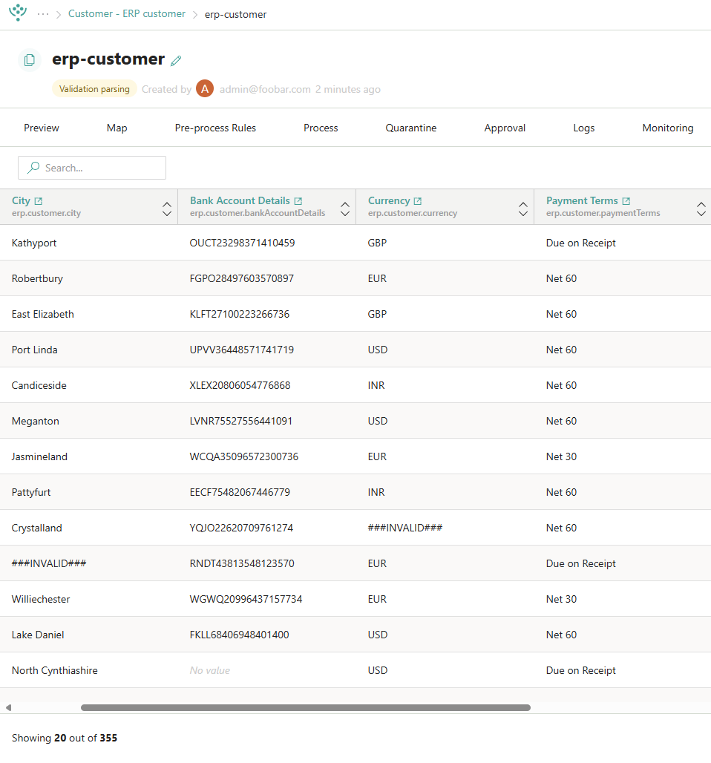


Learn more about data ingestion in our documentation portal.
Next session: Merging duplicate records.
What’s next?

