Slide 1
Welcome to CluedIn training
This training will guide you step-by-step through CluedIn, a modern master data management platform built to simplify, automate, and connect your enterprise data.

Slide 2
Built for data professionals at every level
Who is this training for?
Whether you are a:
Head of Data
Data Steward
Data Engineer
Analyst
this training will show you how CluedIn brings clarity to your enterprise data - without the chaos of traditional MDM.

Slide 3
Training agenda
Fundamentals
Learn about schemaless ingestion, cleaning, and graph model.
AI & Automation
Explore how CluedIn uses AI for enrichment, deduplication, and intelligent linking.
A four-level
journey
Microsoft Integration
Data Engineering & Azure Databricks
See how CluedIn works natively with Azure, Microsoft Purview, and Microsoft 365.
Integrate CluedIn into modern pipelines using Databricks and Azure for advanced analytics.

Slide 4
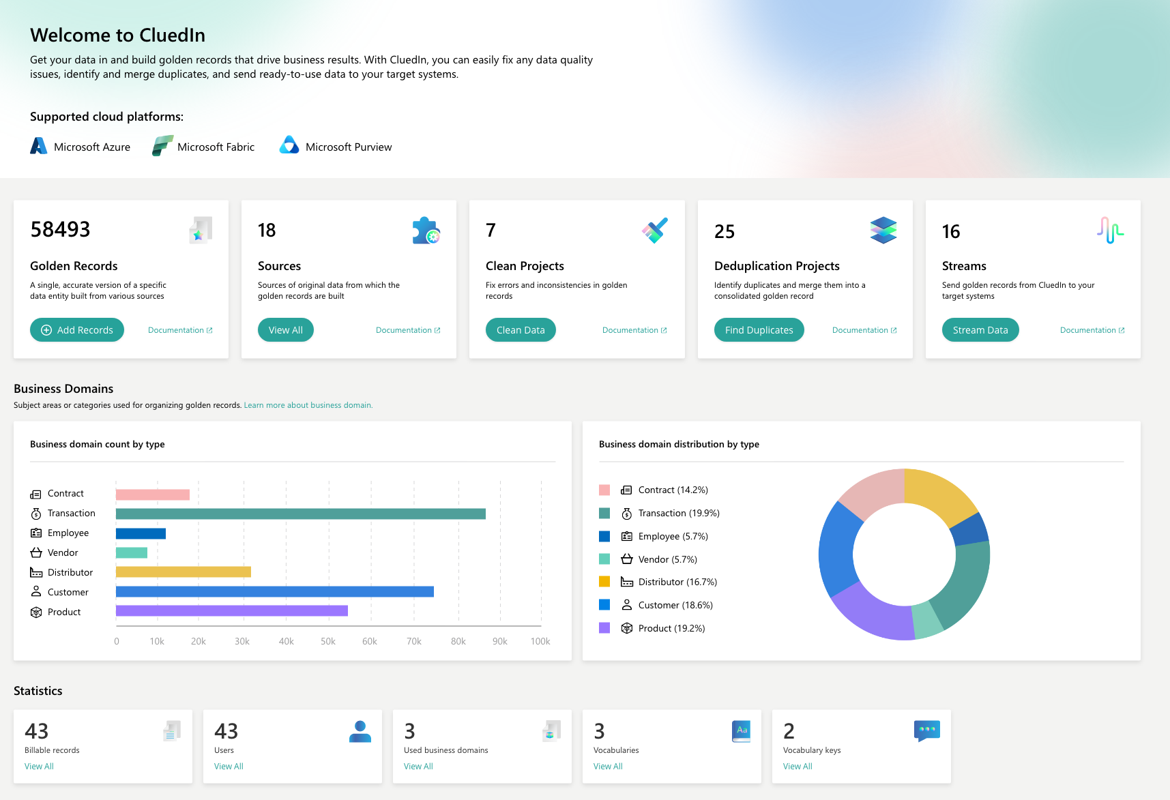
A modern approach to master data management
What makes CluedIn unique?
No schema? No problem.
Ingest data as-is — no upfront modeling required.
Eventual connectivity pattern.
Our graph engine uncovers relationships over time.
AI does the heavy lifting.
LLM-powered automation enrichment, rules, deduplicates, and enriches your data.

Slide 5
Ready to begin?
Trusted data.
Powerful connections.
Real results.
You’re now ready to dive into the platform. Let’s explore how CluedIn can help you unlock the full potential of your data.

